Slide 1
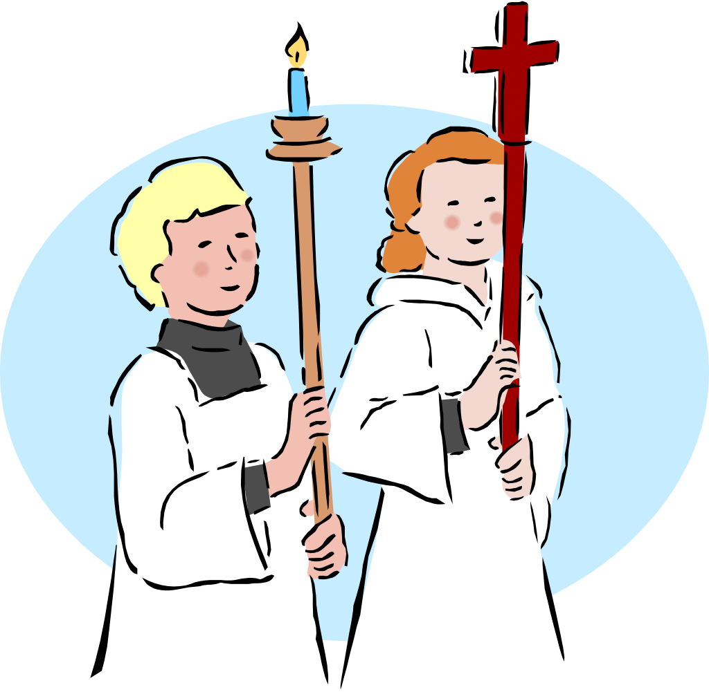
All Saints Catholic Church
Altar Server Program
Called to Serve
Parent Information Sessions
May 2nd and 9th, 2018

Slide 2
Introductions Altar Server Council
Chaplains – Deacon Ed Krise and Deacon Rick Medina
Program Co-Coordinators – Jim McKay and John Nelson
Vestry Coordinator – Brandi Kler
Scheduling Coordinator – Nina Weidle
Mass Coach Coordinator – Nina Weidle
Training Coordinator – Kelly Powers
Social Events Coordinator - Dawne Cueller

Slide 3
Program Requirements
Is Your Child Called to Serve?
Server candidates have a strong desire to serve the Altar of our Lord and Savior, Jesus Christ.
Must be capable of demonstrating appropriate attention and reverence before, during, and after Mass.
He/she must be an active member of All Saints parish.
Must believe in the teachings of the Holy Catholic Church.
Must be at least 7 years old by November 30 of their commissioning year.
Must have already made their First Confession and their First Holy Communion.

Slide 4
Program Overview Becoming an Altar Server
Servers begin the program as Apprentices, or “shadows”. They wear only the black cassock and are mainly there to observe and learn. During this period they are also studying the Altar Server manual and completing the Novice Self-Study Module (parent-directed).
Apprentices must shadow at least 6 times, complete the Novice Self-Study Module, and receive a final assessment before they can be commissioned to the initial rank of Novice.
Once commissioned, new servers receive a surplice (white vestment top), black sash (indicating the rank of Novice), and an altar server pin. They are responsible for keeping their vestments clean and in good condition.
As quickly as the kids outgrow their school clothes, they also outgrow their vestments. Their Mass coach will inform them when it is time to exchange vestments for a larger size. After cleaning their old vestments, servers can exchange them in the altar server closet located in the Usher room.
New servers are assigned to a team consisting of two other servers plus an adult Mass Coach (more on coaches shortly).
Teams rotate through weekend Masses (except holiday masses) during the calendar year. Each team will be scheduled to serve at each Mass time (including 7:30am Sunday) at least once per year. Teams typically are scheduled to serve one Mass every 4-5 weeks.

Slide 5
Program Overview Ranks and Promotions
Novice (black sash): At least 7 years old, a rising 3rd grader by November 30, and active in the altar server program for at least 4 months
Skilled (red sash): At least 9 years old, a rising 4th grader, and active for at least 8 months
Master (red sash with gold trim): At least 11 years old, a rising 6th grader, and active for at least 12 months
Guardian (gold sash): At least 14 years old, a rising 9th grader, and active for at least 12 months
Promotions can be achieved as the servers grow in age and experience. The server’s parent is notified by email in June when their child is eligible for promotion.
Servers seeking a promotion must complete a self-study module and fill out a Petition for Promotion form. Their mass coach must sign off on the petition certifying their readiness. The servers will also be observed at least one time serving a Mass either by one or both program co-coordinators or another mass coach.

Slide 6
Program Overview Scheduling Expectations
Apprentice Servers (shadows) do not sign-up for Mass, they may just show up and observe. Once they feel comfortable doing so they may take a seat on the Altar and even participate in serving the Mass. Otherwise, they may sit in the first row and simply observe.
All servers are expected to serve a minimum of 15 times per calendar year to be considered for promotion. However, they are typically only be assigned to serve at 10-12 masses. The remainder are made up by signing up for open slots on the schedule.
Each regular Mass is assigned a rotating team of three servers. Each Mass also has three “open” server slots that are first come, first served. There are only enough jobs for six servers at a typical Mass.
In addition to their scheduled masses, all servers may sign-up for as many or as few additional masses as their schedule permits.
Special masses are NOT scheduled using the rotating team concept. Each of the 6 server slots to these masses are considered “open” and available on a first come, first served basis.
Special Masses include: Christmas Eve, Christmas Day, Holy Thursday, Good Friday, Easter Vigil, Weddings, Confirmation, Vacation Bible School, Thanksgiving Day, First Communion, and the Parish Mission. Funerals are covered by Knights of Columbus acolytes.
Servers who are not able to attend – as scheduled - are expected to find a substitute.

Slide 7
Program Overview Mass Duty Assignments
Upon arriving to Mass, the SCHEDULED server with the highest level (at 20 minutes prior to the start of Mass) assigns all other servers to available jobs and communicates to the Lectern the first names of all the participating servers.
If there is more than one SCHEDULED server present with the highest level, then the oldest server is responsible for assigning jobs. If there are two servers with the same high rank, then the leader becomes the older of the two.
If a server(s) arrives late and jobs have already been designated, then the late server(s) may participate as “observers” regardless of their rank.
A high-ranking server who arrives late to Mass relinquishes their right to lead the other servers at that Mass. Servers who are consistently late or miss a scheduled Mass (without finding a substitute) may be held back from a potential promotion or even eventually asked to leave the program.
Mass coaches make notations in the Mass coach assessment book which server(s) are, or are not, on time and ready to serve (i.e. already wearing their vestments).
Note: if there are no servers scheduled for a specific mass, then the server with the highest rank (at 20 minutes prior to the start of Mass) assigns all other servers to available jobs.

Slide 8
Program Overview Mass Coaches
Mass coaches are typically, but not always, a parent of one of the servers on their team. No experience is necessary. Initial training is provided and refresher training available on a continuing basis. Candidates are required to complete VIRTUS training and submit to a background check. Please consider serving with your child.
Mass coaches are there to support the servers. The goal is always improvement, NOT perfection.
Mass coaches remind the servers to be reverent from the time they arrive to serve until the time their after-Mass duties are complete.
During the Mass, the Mass coaches observe the servers from the pew. A Mass Coach Assessment Book is used to help assess each server’s performance. Immediately after the Mass, the Mass Coach offers positive and constructive feedback to the servers.
The Mass coach may refer a server(s) on their team for refresher training. Coaches should also attend one training session per year.
Mass coaches sign off on Petitions for Promotion.

Slide 9
Next Steps
Entering and serving in the Sanctuary is a privilege. Decide if your child is capable of carrying out the duties of an Altar Server with attention and appropriate reverence. Then allow your child to determine for him/herself whether, or not, they truly feel called to serve.
Fill out the New Server Application (available in the Altar Server section of the All Saints website).
Once the application is approved, you can immediately download the Altar Server Training Manual for you and your child to begin reviewing.
You will be notified of the date(s) and time of the New Altar Server training session. This is a hands-on training session at the church that takes approximately 1 1/2 hours.
At the conclusion of training, new servers obtain an appropriately sized black cassock that they will take home with them to wear while shadowing at Mass this summer.
New servers may shadow as much as they like, but they must shadow at least 6 times before they can be commissioned. They do not need to sign up for a Mass in order to shadow, but they do need to arrive 20 minutes prior to the start of Mass so they can also observe the pre-Mass duties and stay 10 minutes after Mass to observe after-Mass duties.
During this time they will continue to study the Altar Server manual and complete the Novice Self-Study Module (available on the website).
They will participate in a final training session to assess their knowledge prior to being approved for the Commissioning Mass in the Fall.

Slide 10
Program Overview New Server Timeline
May 2nd and 9th: New Parent Information Meetings (You are here!)
Month of May: New Server Applications are accepted
Monday, May 14: New Server hands-on training session 5-6:30pm in the church
Wednesday, June 6: New Server training 5-6:30pm in the church.
Early June - August: New Server Shadowing begins in conjunction with completing the Novice Self-Study Module at home
August: Turn in Self-Study Modules and participate in New Server Assessment session
Oct/Nov (Date TBD): Altar Server Commissioning Mass (for existing servers receiving promotions and new servers)
After Commissioning: Server Team Assignments / Re-assignments. Sign Up Genius is repopulated through January.

Slide 11
Questions?
Thank you and your child for your consideration of this important ministry!

